Slide 1
GANs
https://github.com/timestocome/DeepLearning-Talks

Slide 2
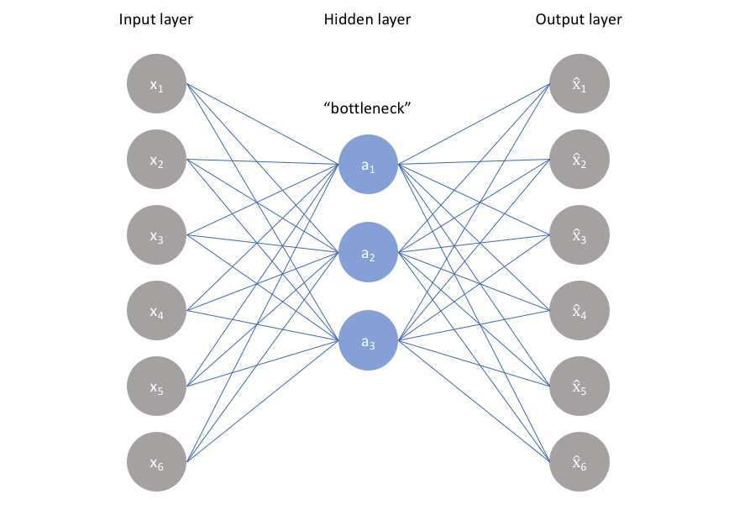
AutoEncoders
Compression, noise removal
Z space, Latent Space, Bottleneck
data need not be labeled
still used internally in complex GANS
… and other neural networds

Slide 3
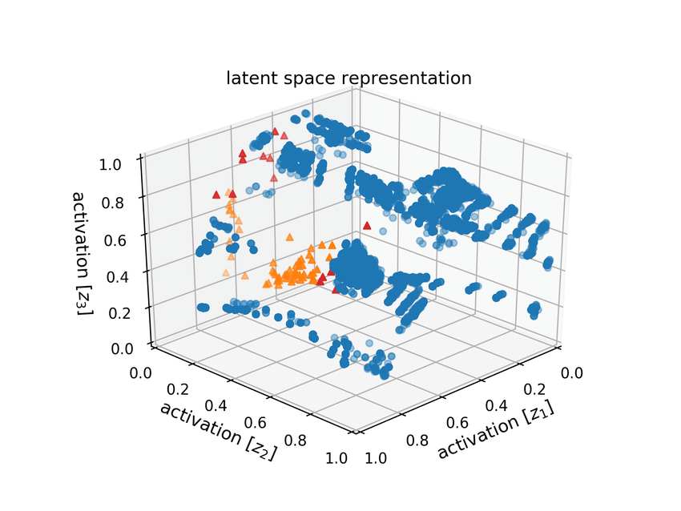
Latent Space, Z space
Not continuous
Can be mapped onto data but
poorly grouped, can't create similar
data

Slide 4

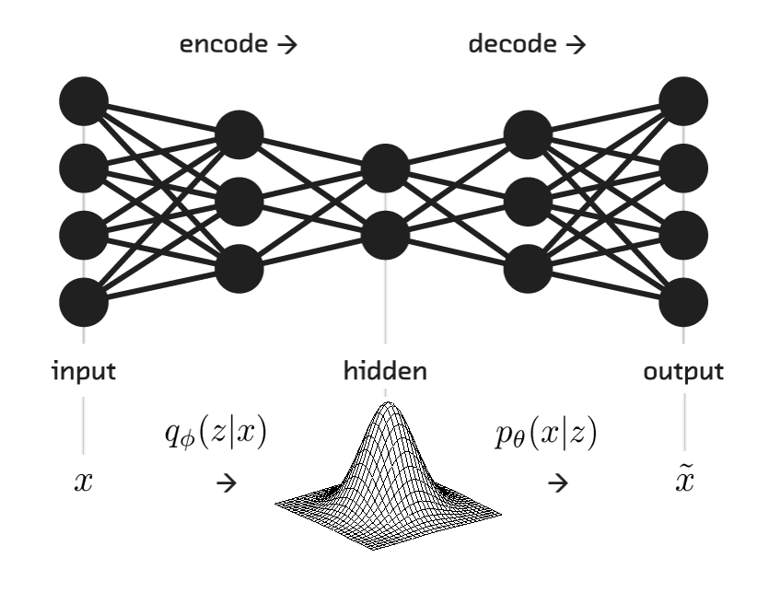
Variational Auto Encoders
Continuous Z Space, learns distribution
Binary Cross Entropy + KL Divergence
Similar data grouped together
Can create similar data
How VanGogh is it?
How is this measured?

Slide 5
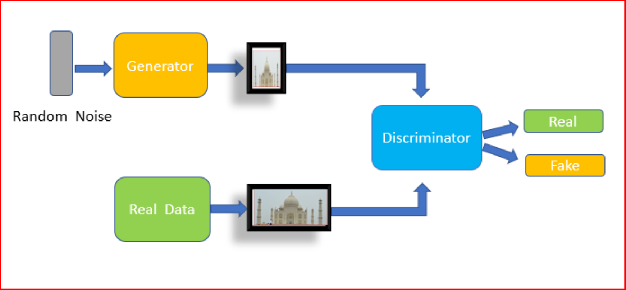
GANs
Discriminator ( Critic ) determines error
Generator can be used to create new data ( medical imaging )

Slide 6
Training GANs
for each batch:
take a random real example, and generated fake and classify them
compute error and update Discriminator
take random noise and create fake example for Discriminator to classify
compute error and update Generator

Slide 7
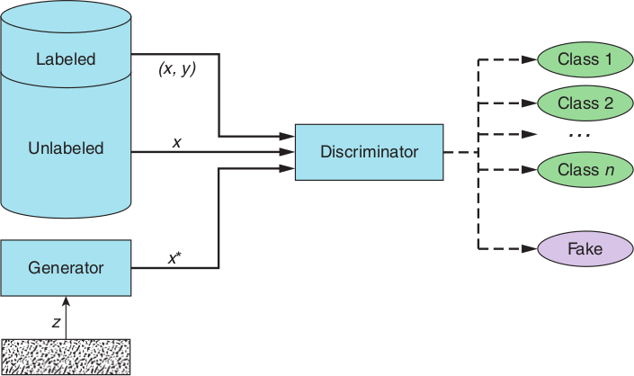
Semi Supervised GAN
Can be used with partially labeled data ( Kannada/MNIST )
( different distribution btwn train/test/val data, used only 4k labeled images of 40k, 81% accuracy)

Slide 8
Things to remember
Changing the cost function has led to big breakthroughs in ML (GANS, RL)
Compound cost functions are difficult to train (mode collapse - mae)
None of the above can be a useful class ( image recognition )
Networks can be designed to label data, or augment data

Slide 9
Code
Semi Supervised GAN Kannada code https://github.com/timestocome/DeepLearning-Talks/tree/master/GAN%20Talk
RL GANs —- World Models https://worldmodels.github.io/
Really Awesome GAN resources https://github.com/nightrome/really-awesome-gan
Keras GANs https://github.com/eriklindernoren/Keras-GAN
Numpy GAN https://github.com/shinseung428/gan_numpy

Slide 10
Resources
Paper
Generative Adversarial Nets
https://papers.nips.cc/paper/5423-generative-adversarial-nets.pdf
Books
Generative Deep Learning: Teaching Machines to Paint, Write, Compose, and Play (O'Reilly)
GANs in Action ( Manning)

Slide 11
Misc
Papers with Code: https://paperswithcode.com

